Slide 1
Comp 2000, Data Structures Application 4/List: CardGame: War
Group 21: Michael Rivnak – Pile, Deck, and Game Kai Arsenault – Card and Game Ernest Shedden – Player and Game

Slide 2
Application
Simulate the card game War
Deck is split between players and each turn players show their top card
The greatest card wins the hand, if there is a tie those players draw 4 cards and compare the 4th one.
This is done until only one player has cards

Slide 3
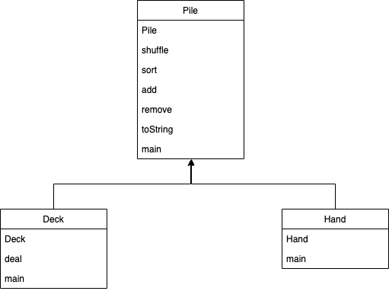
Pile, Deck, and Hand Classes

Slide 4
Issues and Solutions
IndexOutofBoundsException
Use size() where ever possible
EmptyStackException
Make sure that remove() isn’t called on an empty pile
NullPointerException
Make sure that getPlayedCard() was not called when no cards are in play
Game might go on infinitely
shuffle() the pot

Slide 5
Take-aways
Application of Lists
Use and better understanding of inheritance
Importance of Java documentation
Pre-planning and diagrams
Group programming skills and division of labor
Write relevant information to console = easier debugging

